Slide 1
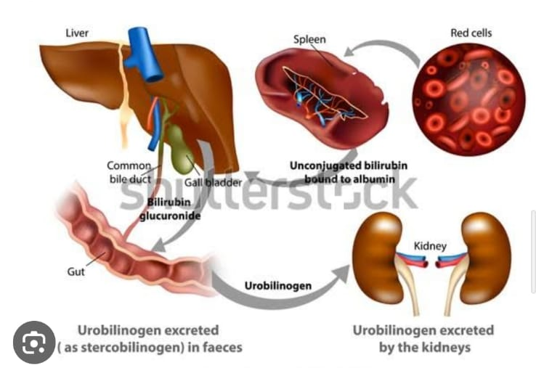
APOLLO COLLEGE OF NURSING
Chennai, Tamilnadu
Bio Chemistry
Group project On
HEME CATABOLISM

